Slide 1

Agile
It’s not something you do,
it’s something you are.
Declan Whelan
Notes:
Add “story” definition.
Add “alignment” as a principle?
Add release and sprint burn-down charts

Slide 2
Waterfall
Requirements
Analysis & Design
Code
Test
Deploy

Slide 3
“The CHAOS Chronicles” 2006 The Standish Group

Slide 4
Notes:
This is of successful projects

Slide 5
Waterfall
Requirements
Business Requirements
Technical Requirements
Analysis & Design
System Specifications
Component Specifications
Code
C#, C, C++ etc.
Test
Deploy
Big-Bang Integration
Validation Tests
Verification Tests
Notes:
This is the “perceived wisdom” – the way that we have been taught.
Developed by Royce – “Managing the Development of Large Scale Systems” Proceeding, IEEE Wescon, August 1970
This model has been misinterpreted – Royce meant to show that this was actually a “bad idea”!
“the implementation described above is risky and invites failure … one can expect up to a 100-percent overrun in schedule and/or costs”
However in practice we have the prevalent notions of:
Get it right the first time.
If only we did a better job of defining requirements then …
The agile community argues that:
The cost of change curve is as much a result of the process rather than intrinsic to software development

Slide 6

“… risky and invites failure.”
Winston Royce

Slide 7
agility
values, principles and practices that foster team communication and learning to regularly deliver customer value through working software
Notes:
Team communications
Focus on communication and collaboration rather than process and tools
Feedback
Lots of internal feedback loops: daily, weekly, quarterly
Get customer feedback often
Regularly Deliver
Release S/W typically quarterly with internal releases weekly or bi-weekly
Value
Focus on highest value features
Working Software
Focus on getting S/W working early and keeping it releasable rather than big-bang waterfall approach
It is not binary … it is a mindset

Slide 8
agile values

Slide 9

individual and interactions
over processes and tools
Notes:
Use of collaborative spaces

Slide 10

working software over comprehensive documentation

Slide 11

customer collaboration over contract negotiation

Slide 12
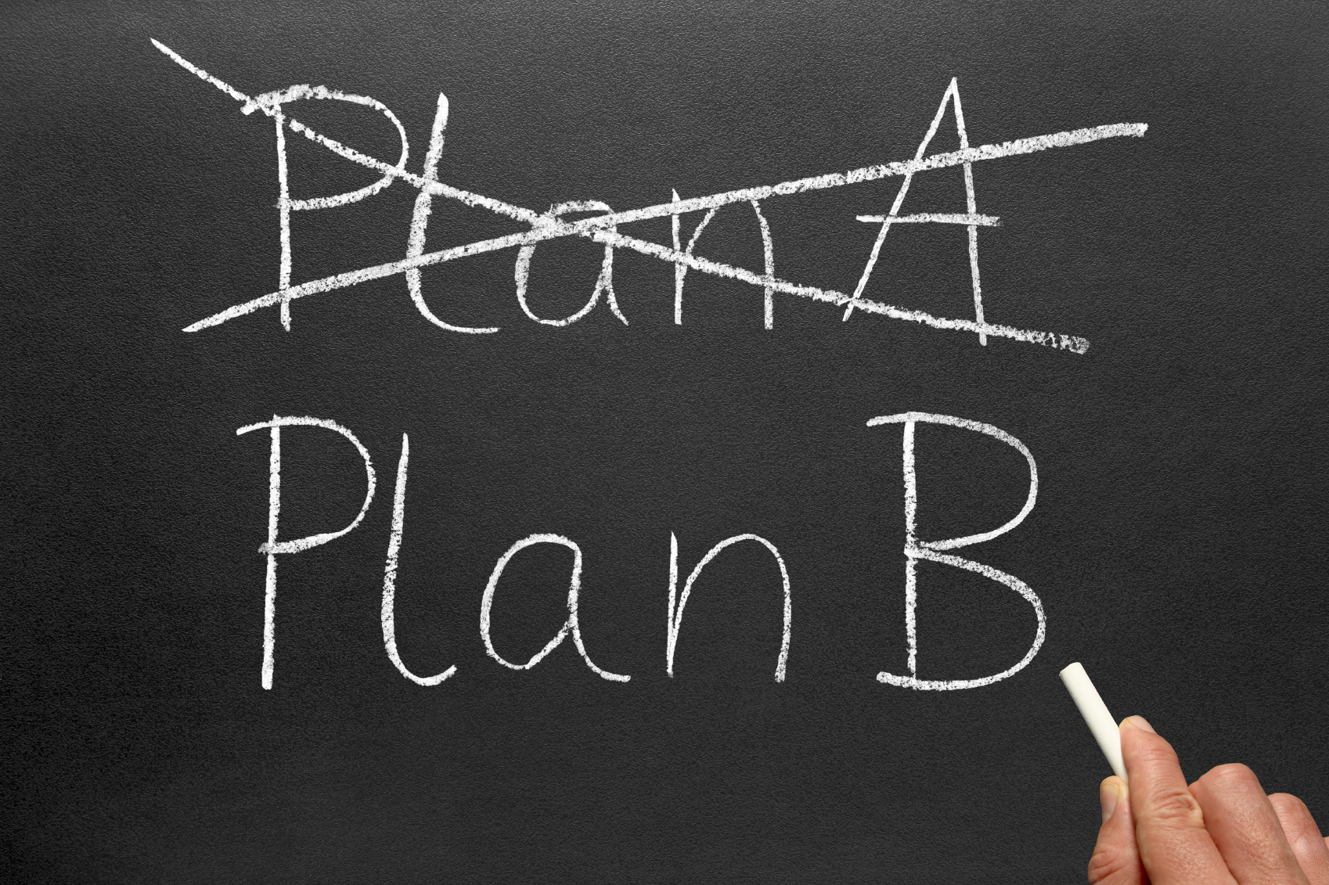
responding to change over following a plan

Slide 13
agile principles
Notes:
Thanks
Main Points
- Agile is a mindset
Values, principles and practices that foster team communication and feedback to regularly deliver customer value through working software
Agile has crossed the chasm – it is widely deployed across many companies small to large and across many domains – including enterprise software
- Agile is like losing weight – easy to understand; hard to do

Slide 14

working software as primary
measure of progress

Slide 15

craftsmanship

Slide 16

emergent design

Slide 17


do the simplest thing that could possibly work

Slide 18




feedback

Slide 19
agile practices
Notes:
Thanks
Main Points
- Agile is a mindset
Values, principles and practices that foster team communication and feedback to regularly deliver customer value through working software
Agile has crossed the chasm – it is widely deployed across many companies small to large and across many domains – including enterprise software
- Agile is like losing weight – easy to understand; hard to do

Slide 20
Agile Practices – They Aren’t New!
Data Hiding
Simple Design
Software Architecture
Cont. Integration
Software Reuse
Documentation
Risk Management
Collective Ownership
Project Planning
Incremental Releases
Test-Driven Design
Coding Standards
Evolutionary Design
Refactoring
Pair Programming 50s
On-Site Customer
Patterns
Metaphor
Requirements forever
Software Metrics
Sustainable Pace
Retrospectives
1960
1970
1980
1990
2000
Source: Software Best-Practices: Agile Deconstructed - Steven Fraser OOPSLA 2007
Notes:
Agility movement has succeeded by embedding proven practices into a cohesive package supported by a mindset focused on core values and principles.

Slide 21
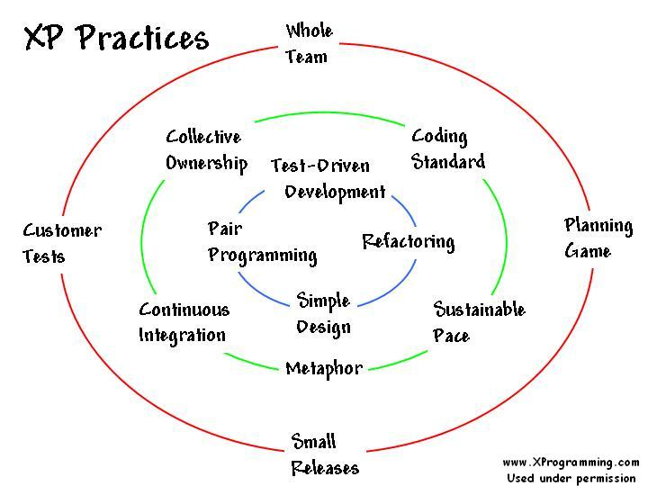

Slide 22
Red Green Refactor
Write the test code
Compile the test code (it should fail)
Implement just enough to compile
Run the test and see it fail
Implement just enough to make it pass
Run the test and see it pass
Refactor for clarity and to remove duplication
Repeat from step 1

Slide 23
Simple Design Rules
Has a test
Intent revealing
No duplication
Minimum number of classes/methods

Slide 24
TDD Resources
“Test-Driven Development” Kent Beck
“xUnit Test Patterns” Gerard Meszaros Rick Mugride, Ward Cunningham
“Pragmatic Unit Testing in C# with NUnit” Andrew Hunt, David Thomas
http://www.testdriven.com
http://www.nunit.org/ - NUnit

